Slide 1
Reasons for software project failure

Slide 2
Introduction
Software development projects have not always been successful.
There are still many reports of software projects going wrong and ‘software failures’.
Software engineering is criticized as inadequate for modern software development

Slide 3
Successful Software Systems…
When do we consider a software application successful?
Development completed
It is useful
Usable
it is used
Cost effectiveness , maintainability implied

Slide 4
Reasons for failures
Schedule slippage
Cost over-runs
Does not solve user’s problem
Poor quality of software
Poor maintainability

Slide 5
Reasons for failures…
Ad hoc software development results in such problems
No planning of development work(e.g. no milestones defined)
Deliverables to user not identified
Poor understanding of user requirements
No control or review
Technical incompetence of developers
Poor understanding of cost and effort by both developer and user

Slide 6
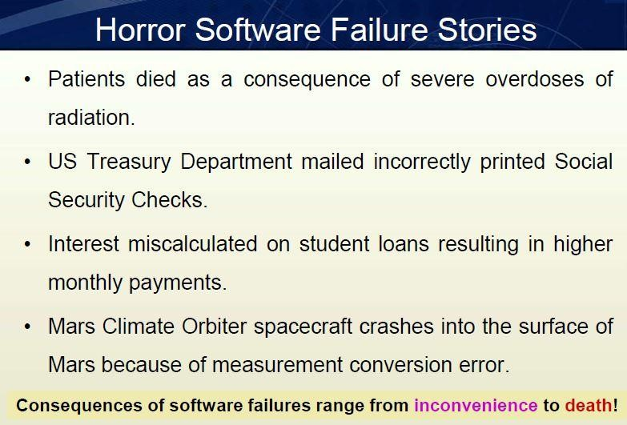

Slide 7
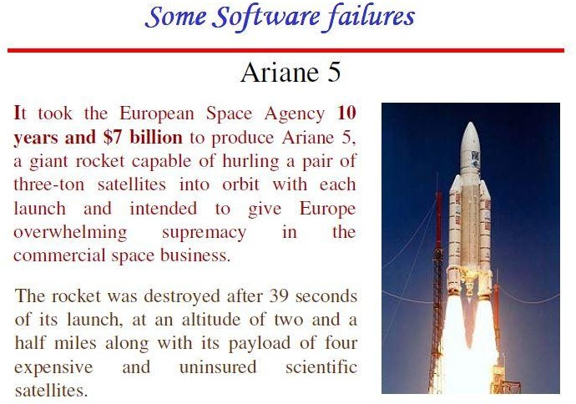

Slide 8
